Slide 1
Project Management
Website BDE

Slide 2
Summary
Context
Communication
Planning
Tasks management
Risks
Human
Equipment
Knowledge
Percentage done
Charter
Conclusion

Slide 3
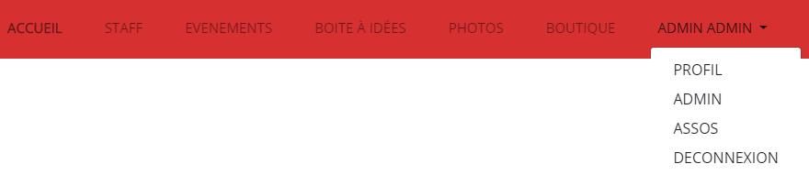
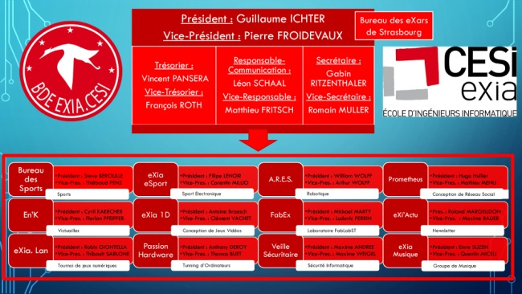
Context
Our navigation bar :
: BDE Website example

Slide 4
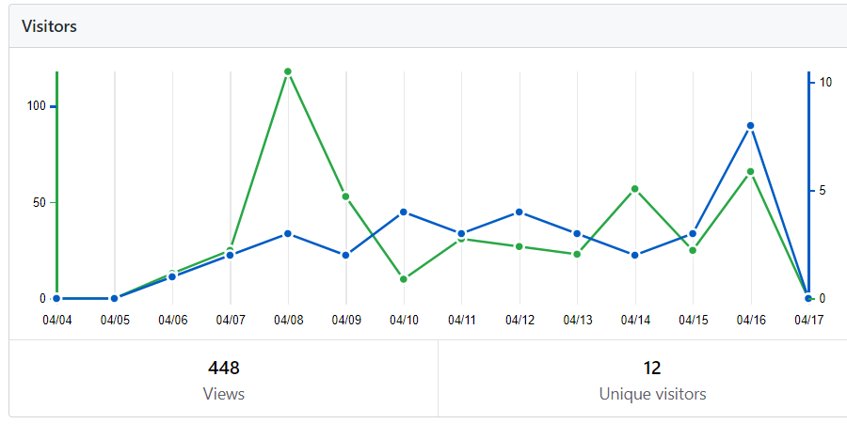




Communication
Trafic of our project on github

Slide 5
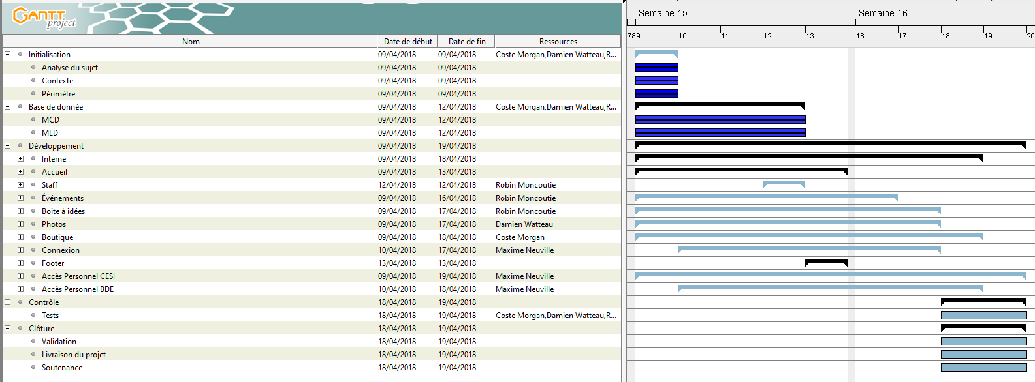
Planning

Slide 6
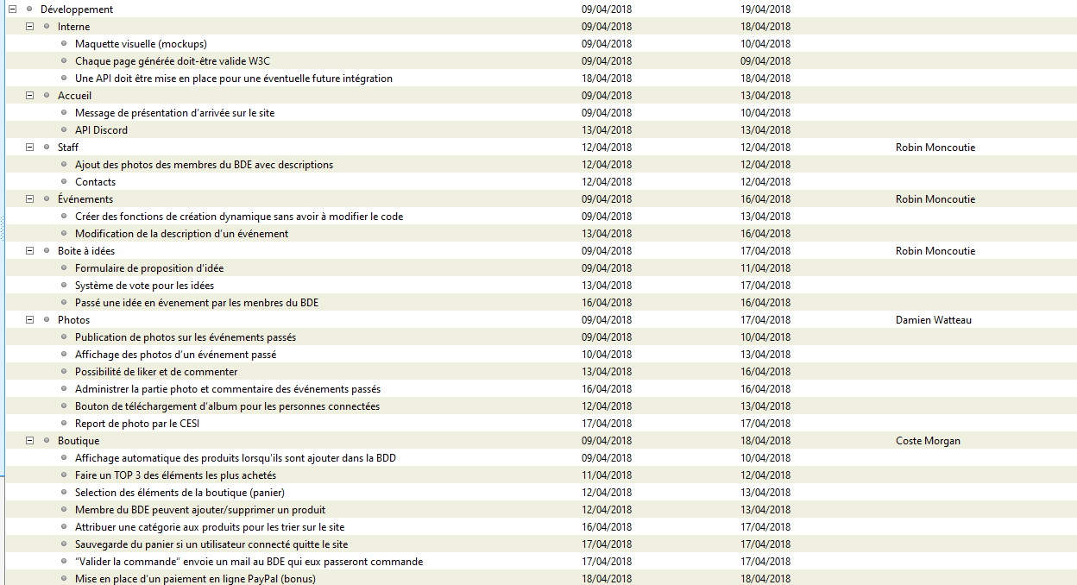

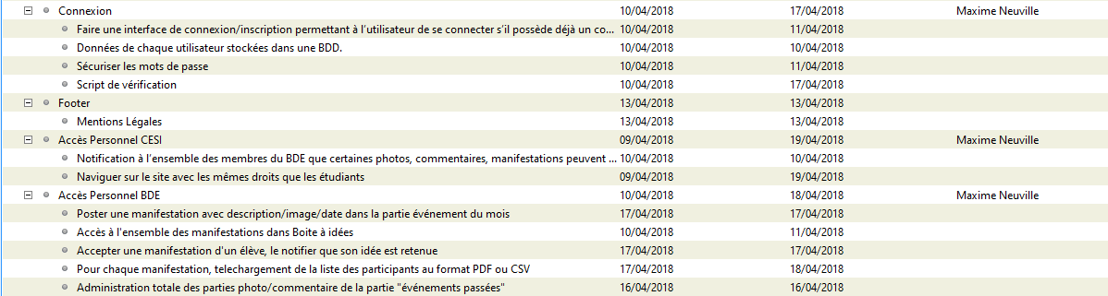
Tasks management

Slide 7

Risks - Human

Slide 8



Risks - Equipment

Slide 9



Risks - Knowledge

Slide 10

Percentage done
Time left until the end: ~25h

Slide 11
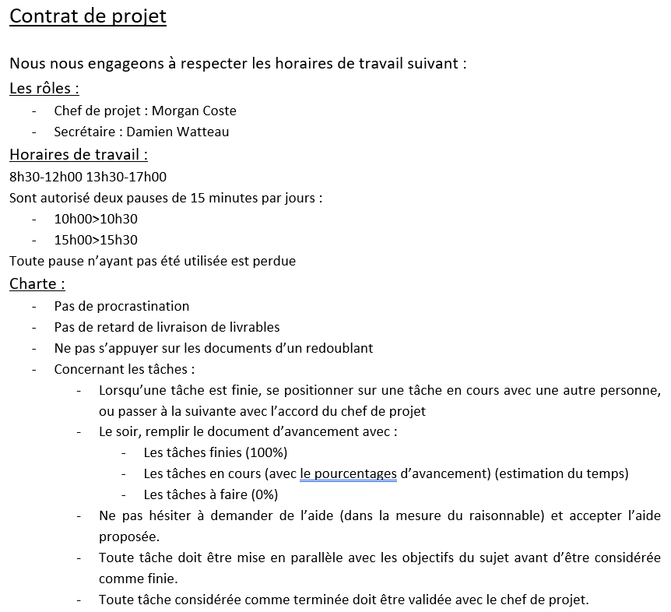
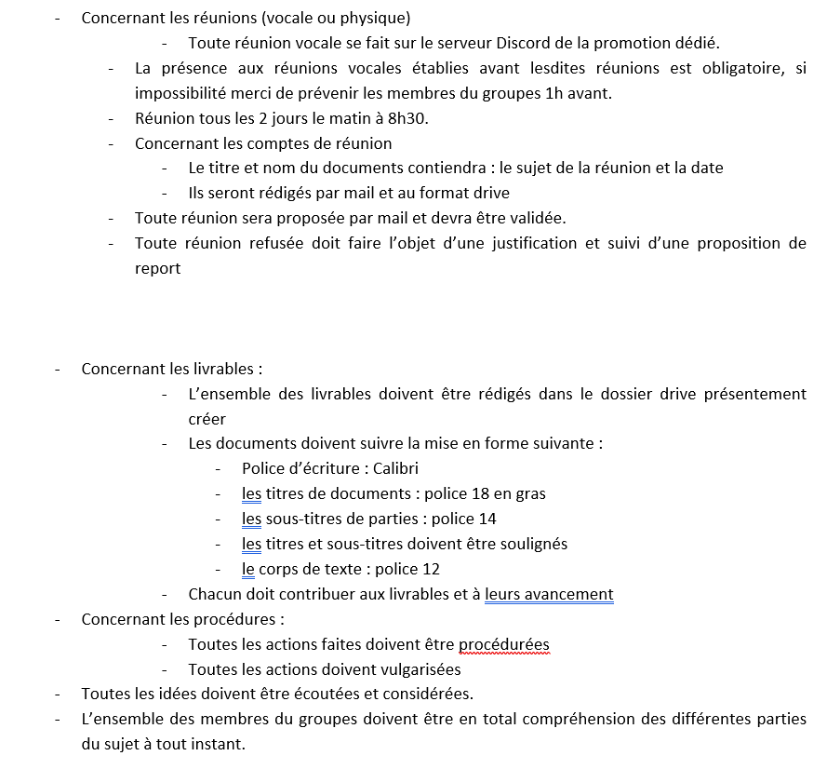
Charter

Slide 12


Conclusion

Slide 13
Thanks you
DO YOU HAVE QUESTIONS ?

